Slide 1
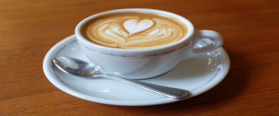
Lucky coffee shop
made by: Gräff Levente – homepage, css, debugging, hungarian presentation Geregely Marci – Coffee page, Blog, Figma Byrappa Arjuna – editing images, english presentation Abousena Adam – cakes, Trello, Figma

Slide 2
Tools we used

Slide 3
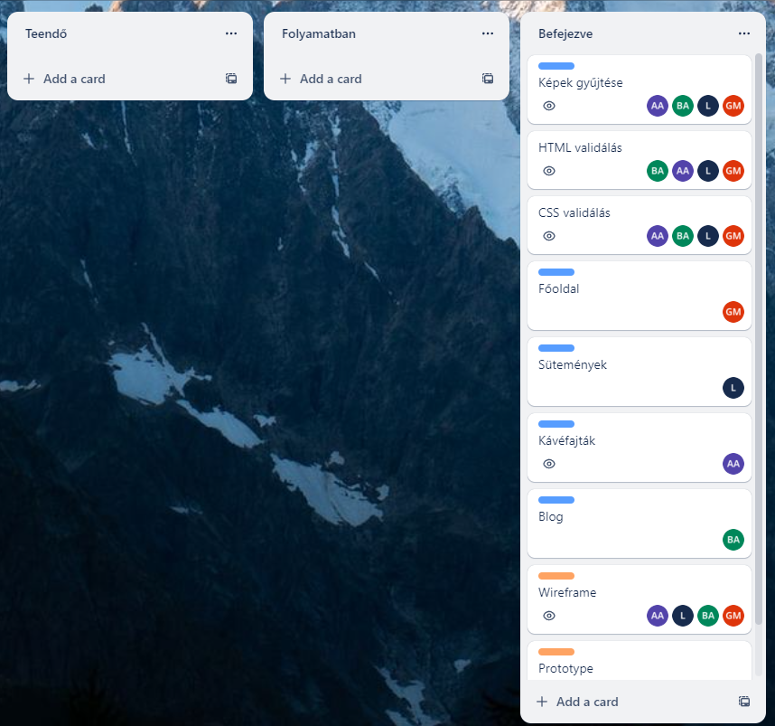
Trello

Slide 4
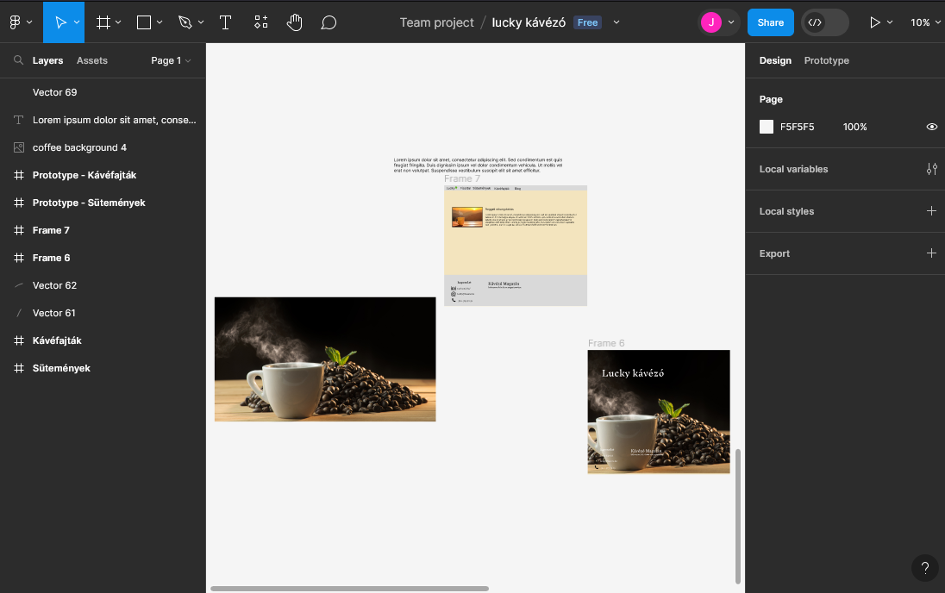
Figma

Slide 5
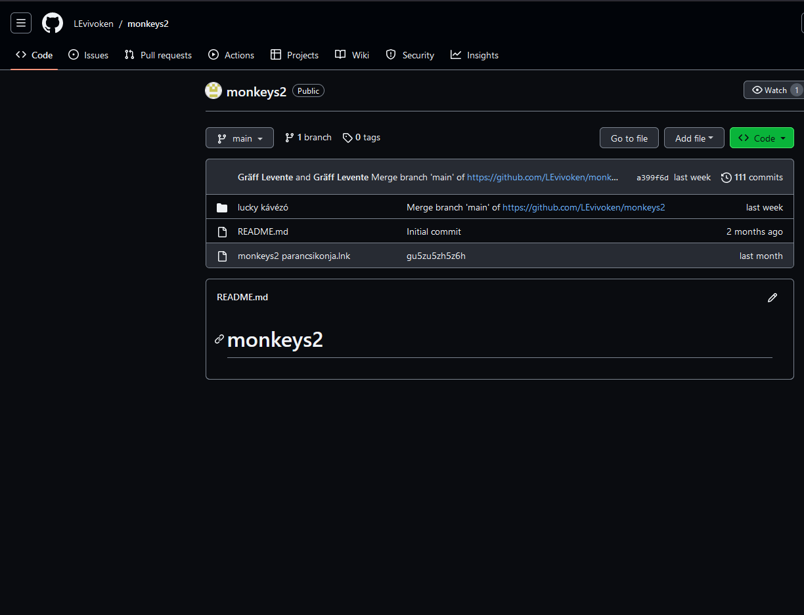
Github

Slide 6
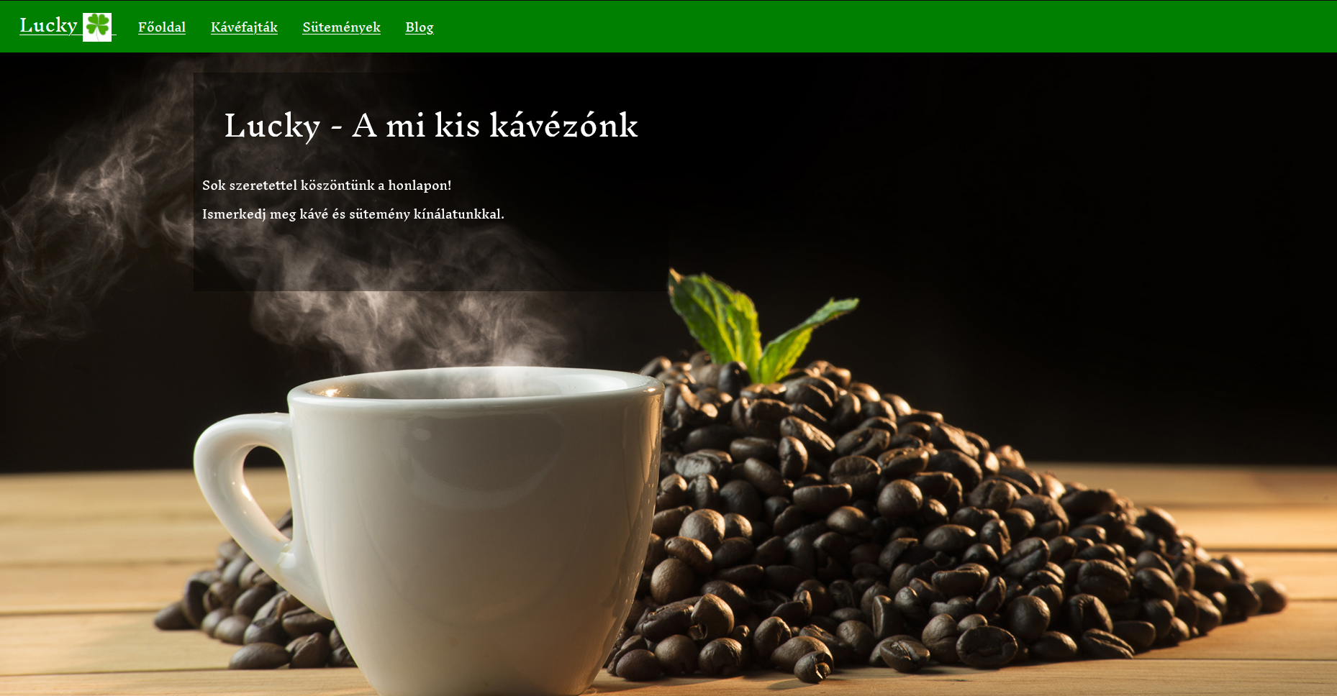
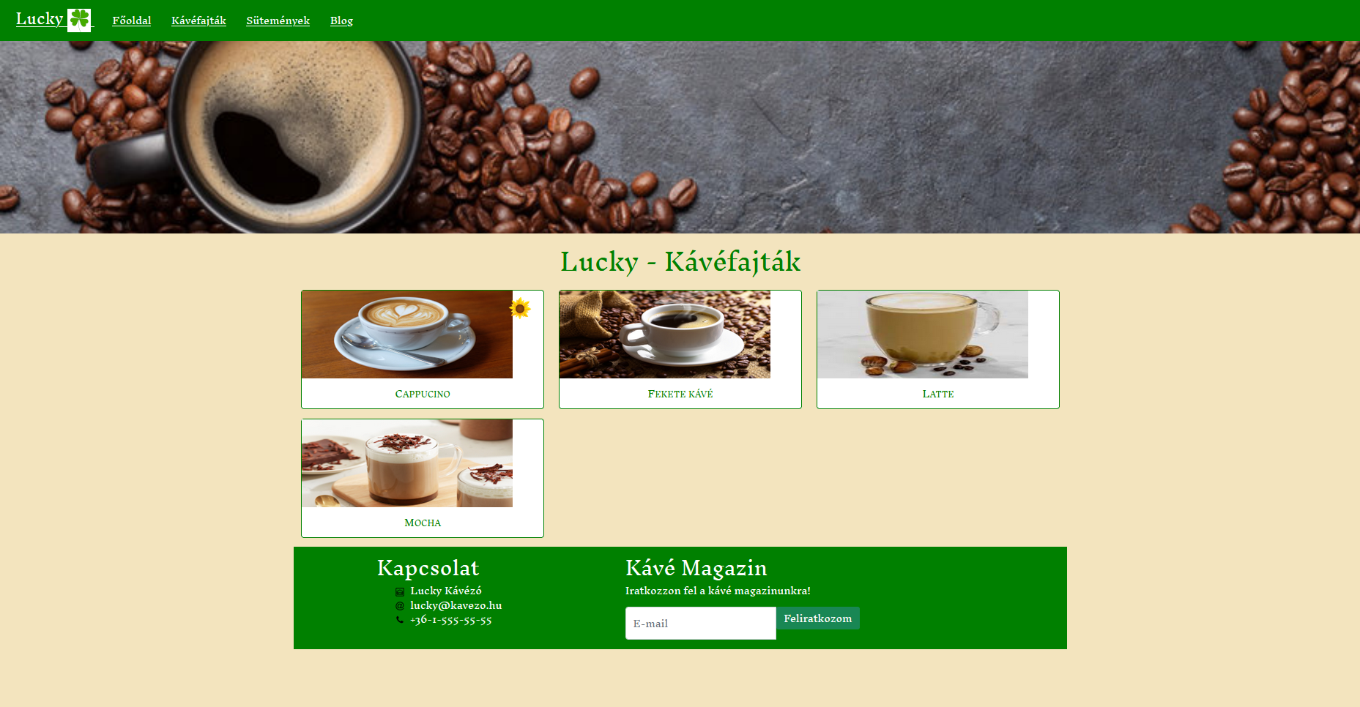
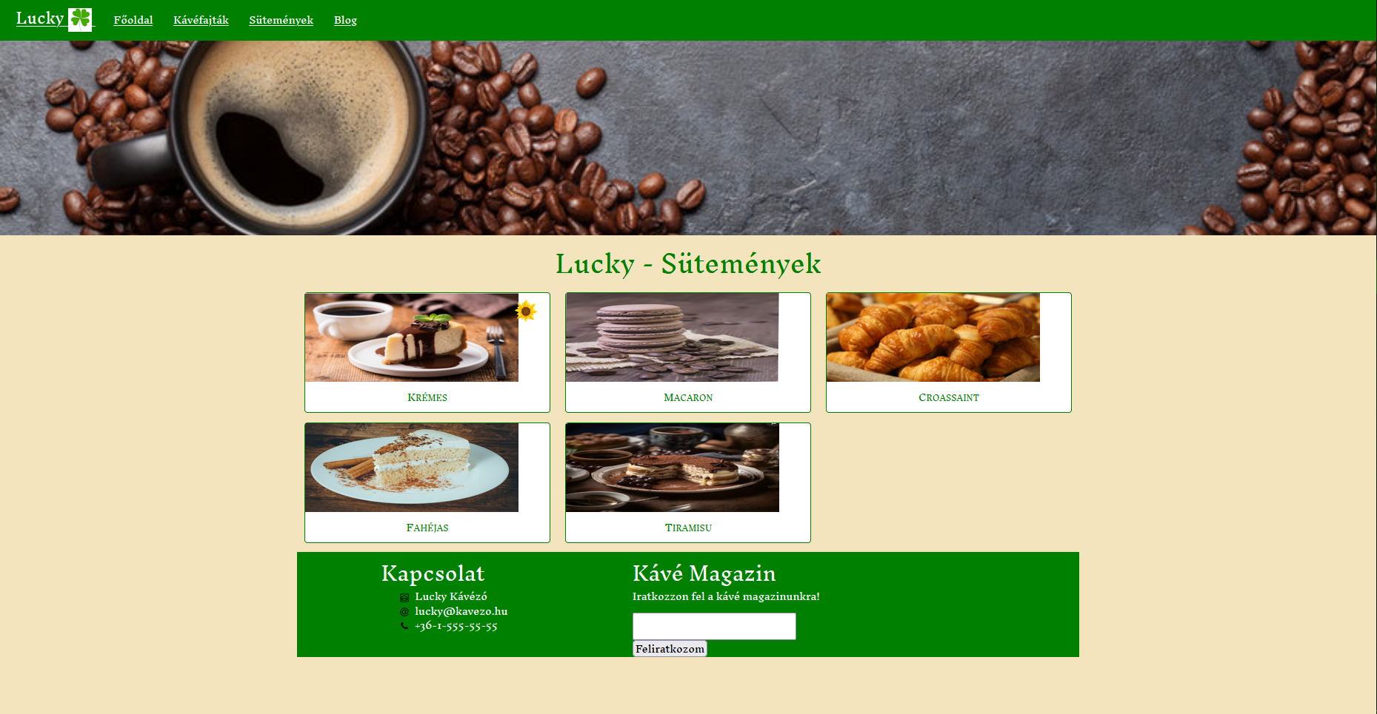
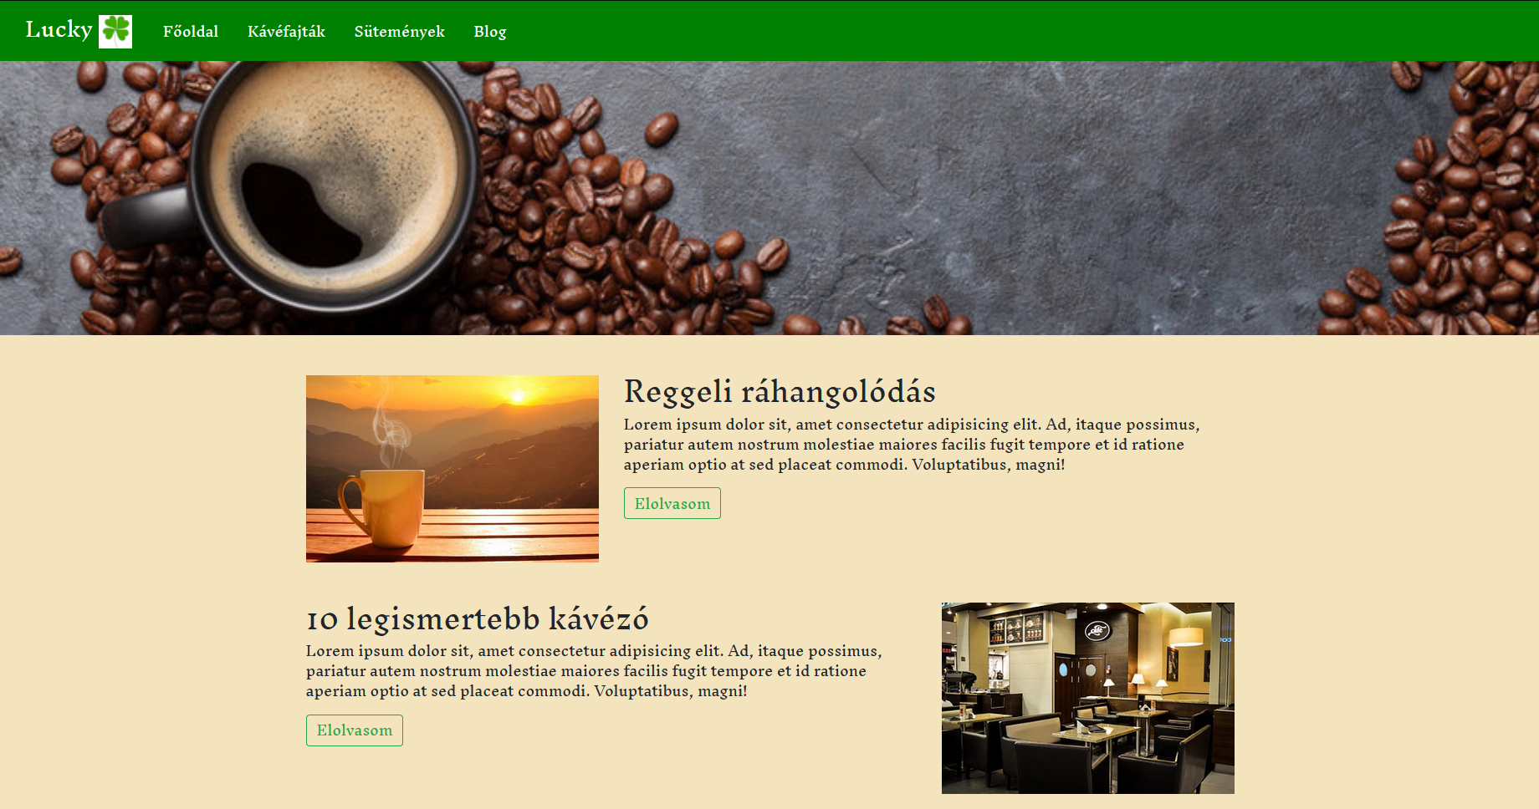

Slide 7
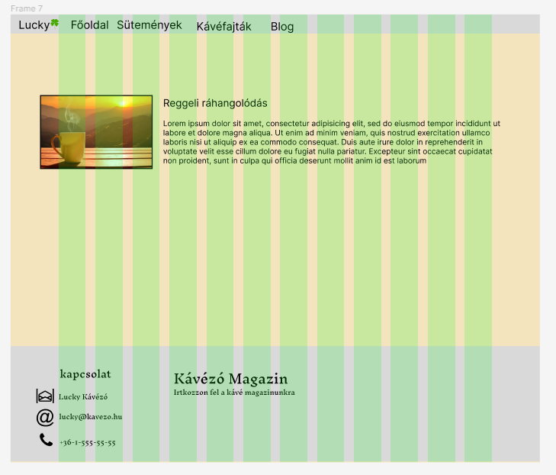
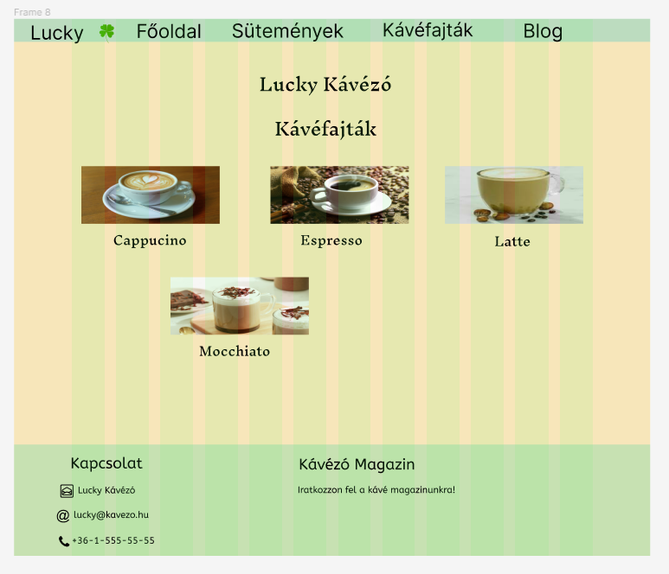
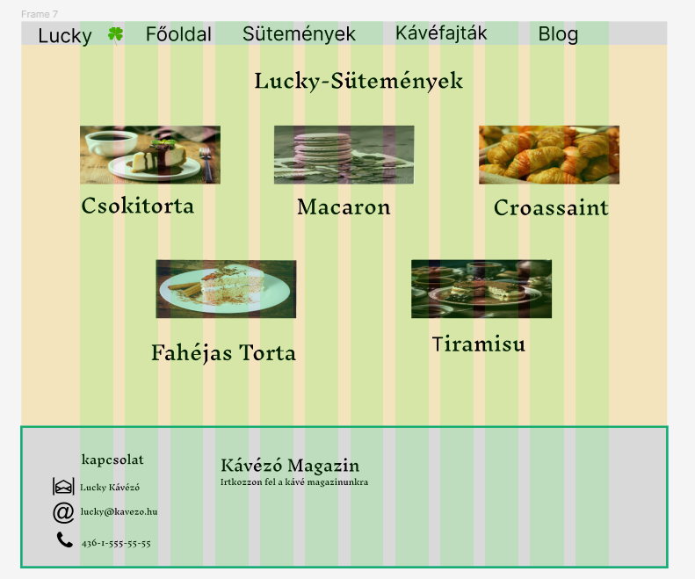

https://github.com/LEvivoken/monkeys2
Prototype/Github link

Slide 8
Thank you for your attention

